Slide 1
COVID-19 TRACKER

Slide 2


SANT GAJANAN MAHARAJ COLLEGE OF
ENGINEERING, MAHAGAON
SITE-CHINCHEWADI. DEPARTMENT OF COMPUTER SCIENCE AND ENGINEERING
Academic Year 2020-2021
NAAC Accredited With Grade B++
Project Name: COVID TRACKAR
Guided by: Prof. C. H. Kamble
Group Member Roll NO.
Ms. Kavita Ashok Patil. 19
Ms. Prajakta Jotiba Powar. 27
Ms. Ashwini Vijay Patil. 08
Ms. Gayatri Appasaheb Patil. 13

Slide 3
INDEX
Problem Statement
Introduction
Abstract
Existing System
Proposed System
System Architecture
Snapshots
Objectives
Features
Requirement Analysis
Conclusion
Reference

Slide 4
Problem Statement
The problem statement for designing the website is to create an latest score to Aware people about covid -19 and inform about all covid cases in the world at one place in a simple way.

Slide 5
Introduction
You know how dangerous COVID-19 is And COVID-19 cases are increasing day by day all over the world
So this project , which provides regularly update of COVID-19 cases in the world and how to prevent form corona virus.
After the user searches the country, the total covid cases of that country shown to user.
At the same time, User also understands what to do to prevent CORONA virus.

Slide 6
Abstract
Covid tracker is web - based project.
It will gives knowledge which things you should do in pandemic and symptoms of covid 19.
This website will be source to update provide of country-level COVID-19 cases and deaths.
The idea behind this project is to help health organization's and people to learn spread of Corona virus

Slide 7
Existing System
There are some other website which can provide covid related information.
But these website have either limited data or huge complicated data.
Which is more complicated and theoretical Which is normal people can not be able to easily understand.
All the information about covid-19 and covid -19 cases around the world are not available at one place.

Slide 8
Proposed System
This project made up of more visualizing cartoon pictures and colourful lines graph like green line for recovered cases and red line for death cases in which illiterate people can understand easily .
The information provided in this website is easy to understand and attractive.
Step 1: open the website.
Step 2: visit first page there are some information about privation of corona virus.
Step 3: click on world cases button.
Step 4:search the country name and it will be show updated covid cases in the form of graph .
Step 5: click on home button so you can redirected towards main page .

Slide 9
System Architecture
User
Covid19 API
Static
Information

Slide 10
Flowchart
Prevention from corona virus
Yes
No
Click on Word case
Word Covid19 cases
Search the country
Country cases
home
Click on home
Click On Search

Slide 11
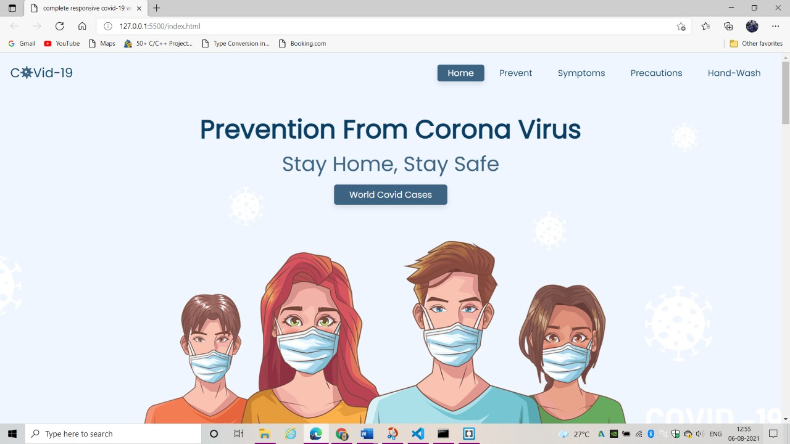
Snapshot
Home Page :

Slide 12
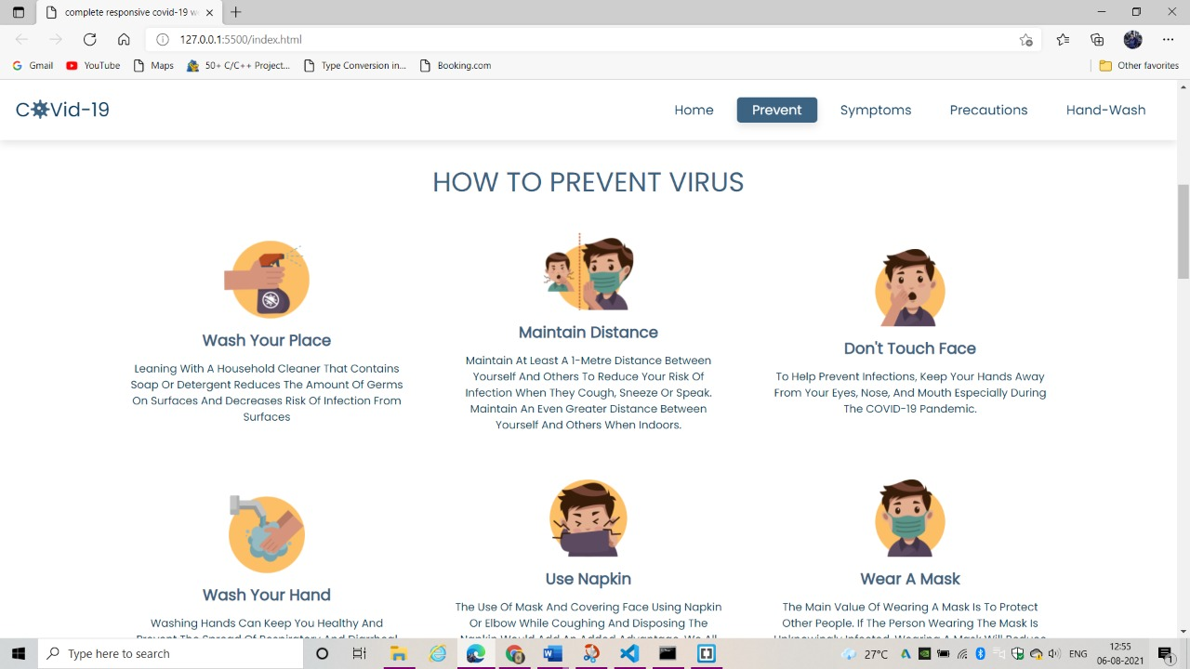
PREVENT PAGE

Slide 13
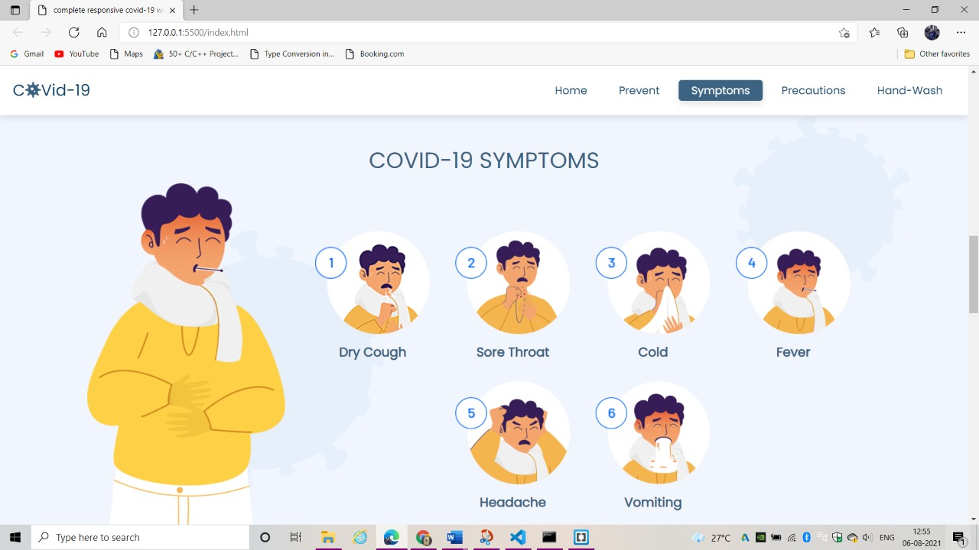
SYMPTOMS PAGE

Slide 14
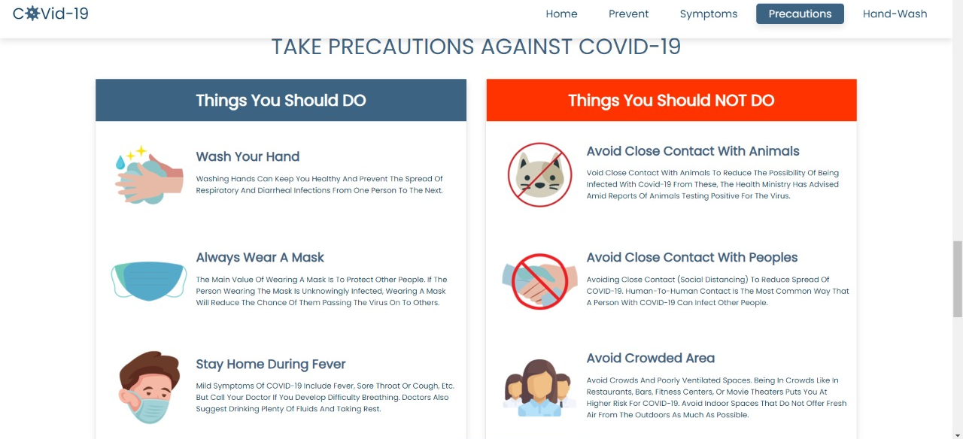
PRECAUTIONS PAGE

Slide 15
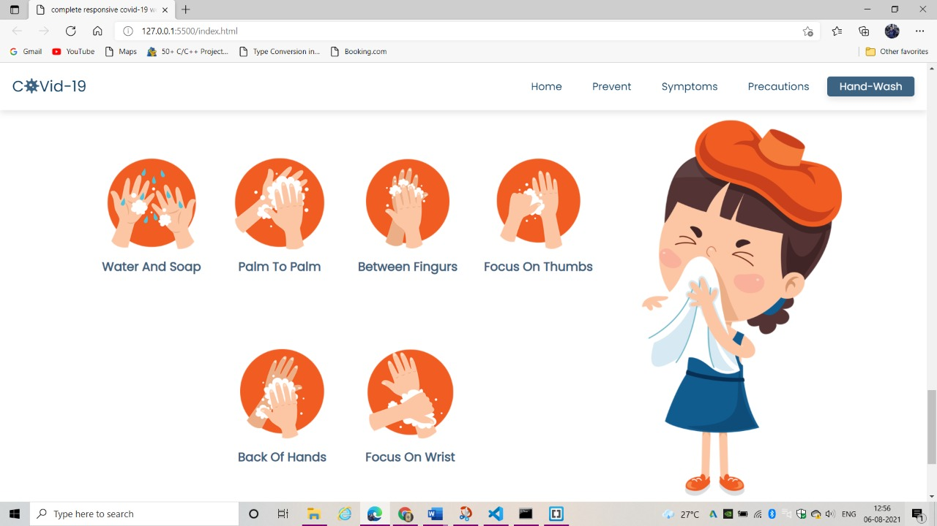
HAND - WASH

Slide 16
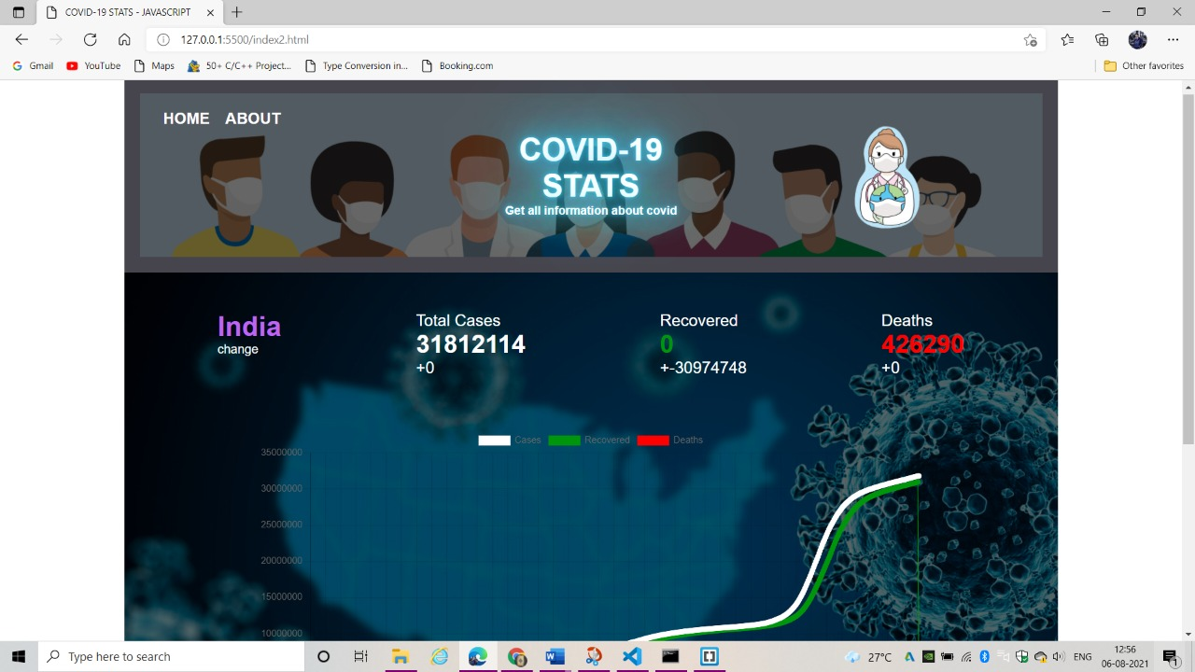
WORLD COVID-19 CASES

Slide 17
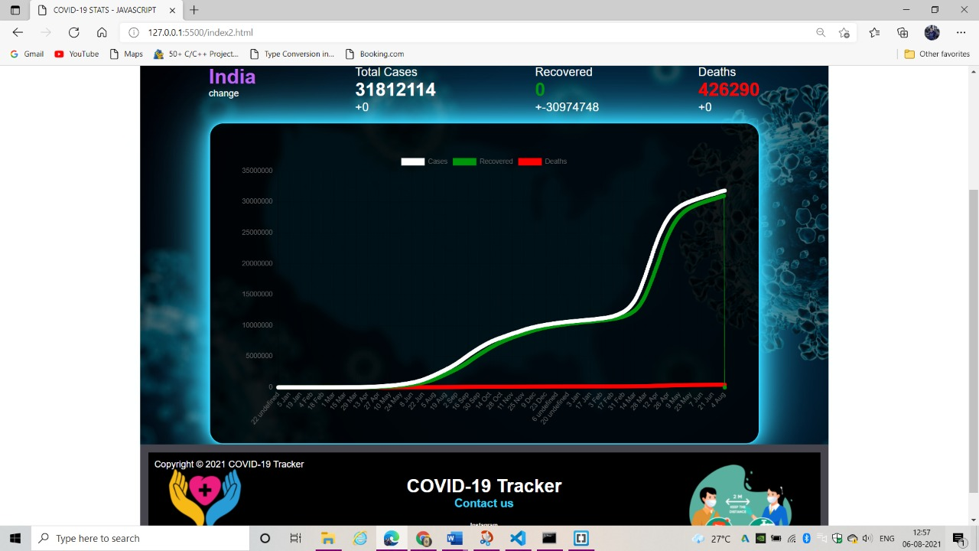
GRAPH PAGE

Slide 18
Objectives
The main goal of this project is to reports data from all countrys of total cases of covid19 infected ,recovered and death cases
Reliable content that will be sufficient for news article and health origination
To aware people about covid19 and take precautions.

Slide 19
Advantages
It will give number of patient in all over the world with the help of covid tracker
It will be helpful for those who are doing research on covid 19 .
doctors and their staff can use this information to spread awareness among the citizens.
Free access to available and easy to understand.

Slide 20
Requirement Analysis
Software specification:
Operating system :- Windows 10, Linux.
Technology:- Visual Studio Code, Any One Browser like Chrome, Microsoft edge.
Language:- HTML, CSS, JavaScript.
Hardware Specification:
Processor:- Minimum dual core i3 or i5.
AM:- 8 GB
Hard Disk:-500 GB Minimum

Slide 21
Conclusion
The research presented current trends of COVID-19 outbreak from January 2020 to August 2021.
In pandemic like this providing timely information to the public
This will be useful for public, Health organization and news reporter.
Easy access for all information at one place.

Slide 22
References
Web References :
https://covidtracking.com
https://en.m.wikipedia.org/wiki/COVID_Tracking_Project
https://youtu.be/8hjNG9GZGnQ.

Slide 23
THANK
YOU

